Slide 1
Project:
Securing the Perimeter
Directions and
Submission Template
Roylan Pais
17-04-2024

Slide 2
Section 1
Designing a Secure Network Architecture

Slide 3
Section 1: Designing the Network
Time to tackle XYZ's perimeter challenges. You've identified that the first thing to do is design a secure network architecture for XYZ. XYZ has provided you a list of business requirements so you can get started on designing a secure layout. Your first task is to incorporate all the requirements securely in a network design.
Use https://app.diagrams.net/ to design a secure network architecture.
Include and label the following requirements in your design:
1) An on-premise network that has 3 workstations in it.
2) A Virtual Network with the following segments:
Public DMZ with two web servers and a load balancer in it.
Private DMZ with two database servers.
Management LAN with one management server in it.
Internal LAN with 5 workstations in it.
Private Secure LAN with 3 database servers.
Additionally include the following:
1) A VPN gateway connecting the on-premise network to your Virtual Network.
2) Show placement of security devices in the architecture, including load balancer(s), firewall(s), IDS/IPS device(s).
3) Show the flow of traffic, and remember to incorporate best security practices with the flow of traffic between the different subnets.

Slide 4
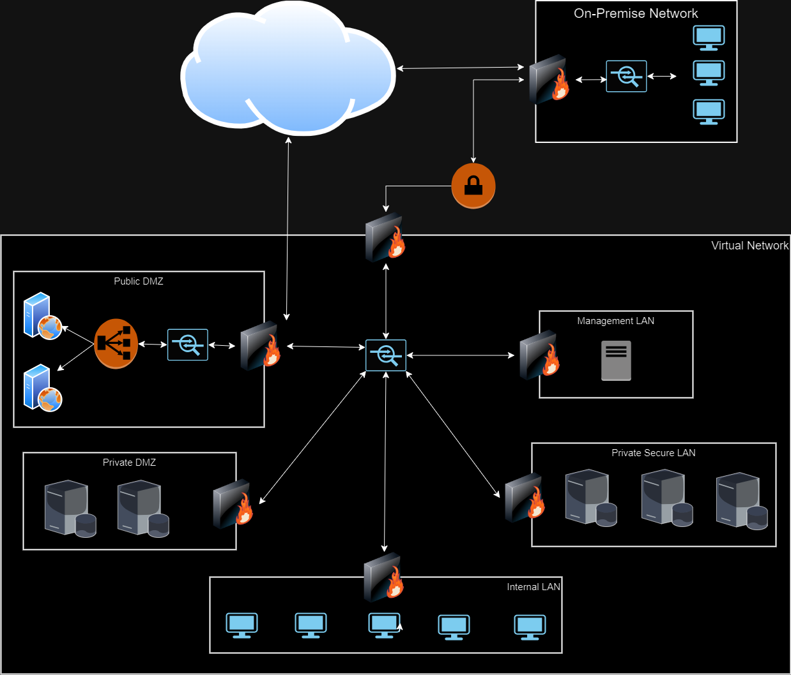
1.1 Designing the Network
Paste your Network Diagram here:
Remove this slide

Slide 5
Section 2
Building a Secure Network Architecture
in Azure

Slide 6
Section 2: Building the Network
After designing the network architecture, you now present your design to XYZ's stakeholders. They're all on board with your design, and have given you the green light to start building the architecture out in Azure.
So your next task is to go the Project Workspace in the classroom, and build out the enterprise network in Azure!
If you are accessing Azure with the Udacity classroom workspace, there will be a Resource Group in Azure called ‘entp-project’ that has already been created for you.
If you are accessing Azure using your own Azure account, first of all you should create a resource group called ‘entp-project’.
This ‘entp-project’ resource group is where you will create all the components that make up this project. When creating VMs in this section, please only use Standard_B1s for your VM size and the Linux Ubuntu 18.04 image.
Insert screenshots of your network on the following pages, showing completion of each of the specified tasks.

Slide 7
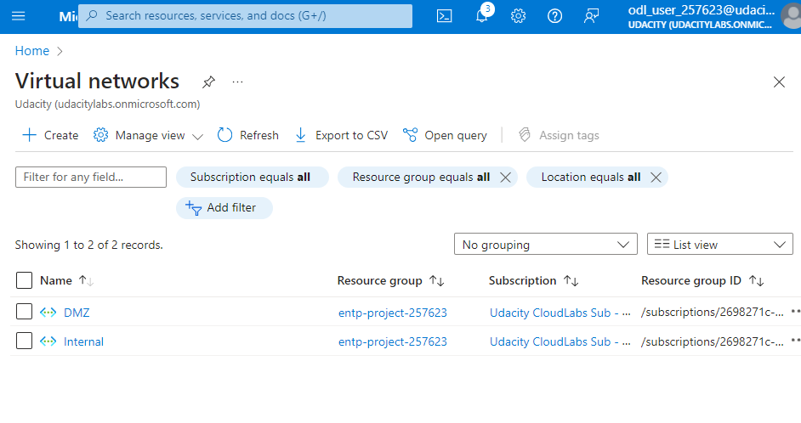
2.1.1 Screenshot
Create two Azure Virtual Networks in the resource group ‘entp-project’. Label one for your DMZ and one as your Internal.

Slide 8
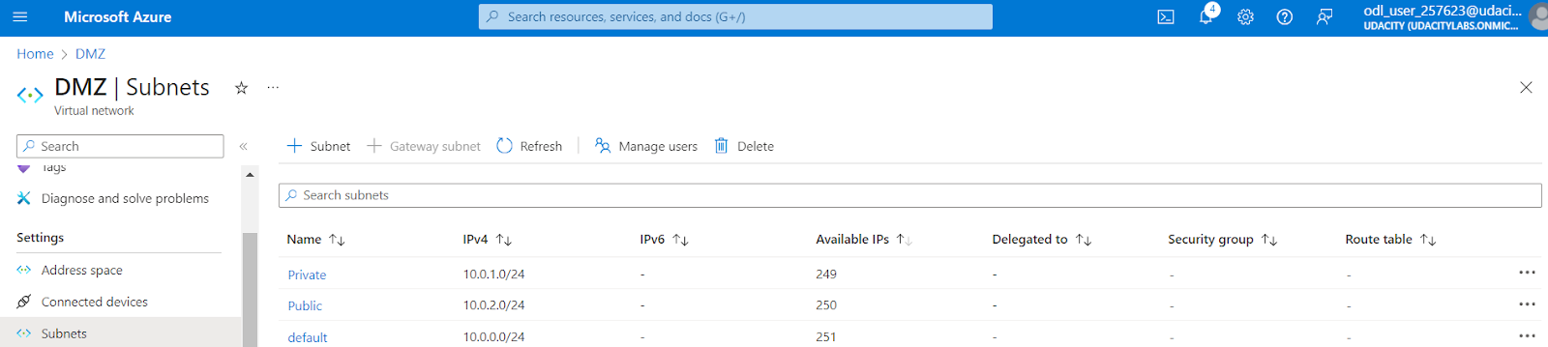
2.1.2 Screenshot
Create 2 subnets within your DMZ - subnets should be public and private.

Slide 9
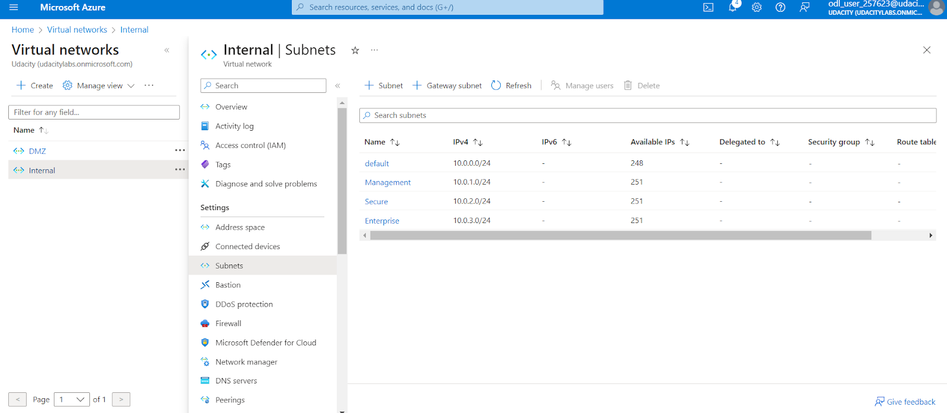
2.1.3 Screenshot
Create three subnets in your internal network and label them Management, Secure, and Enterprise.

Slide 10
2.2 Creating Virtual Machines
In this next section you will create Virtual Machines in your subnets. You will create 2 VMs in your DMZ and 3 VMs in your internal network. Please only use the Standard_B1s VM size and the Linux Ubuntu 18.04 image.
Insert screenshots on the following pages, showing completion of each of the specified tasks.

Slide 11
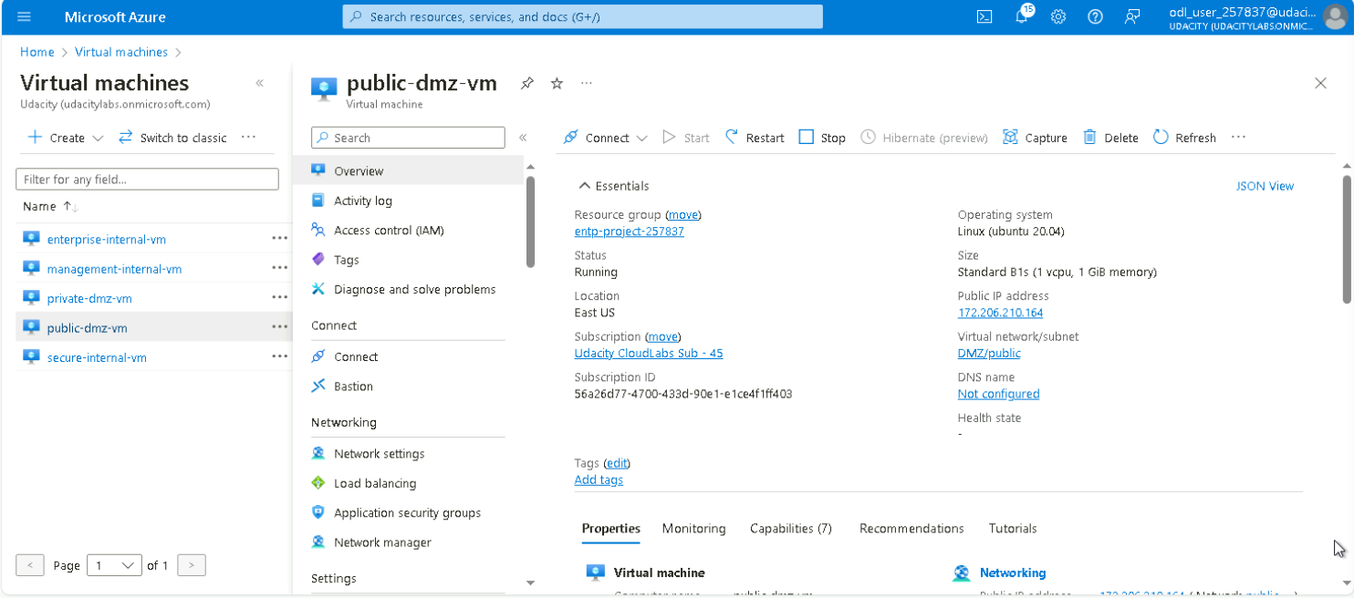
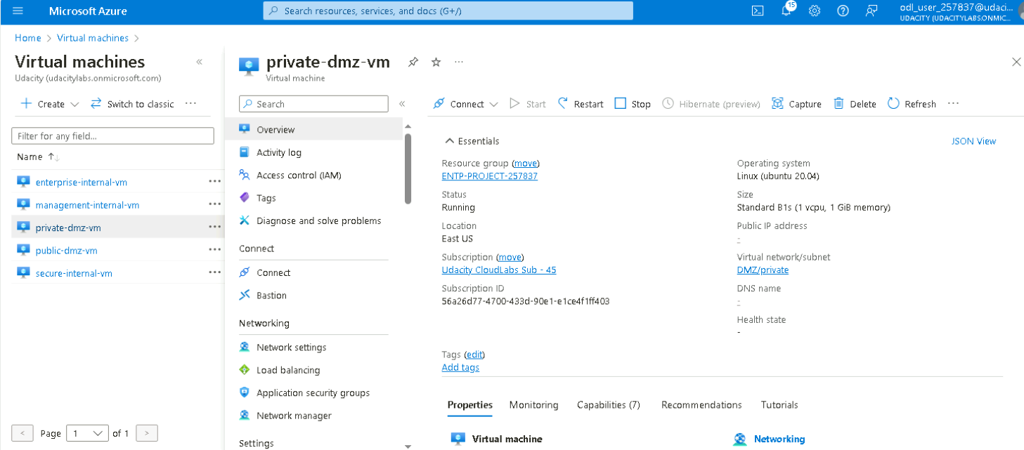
2.2.1 Screenshot
Create one VM in each of your public and private DMZ subnets. Please only use Standard_B1s for your VM size and select the Linux Ubuntu 18.04 image, otherwise you will encounter an error.

Slide 12
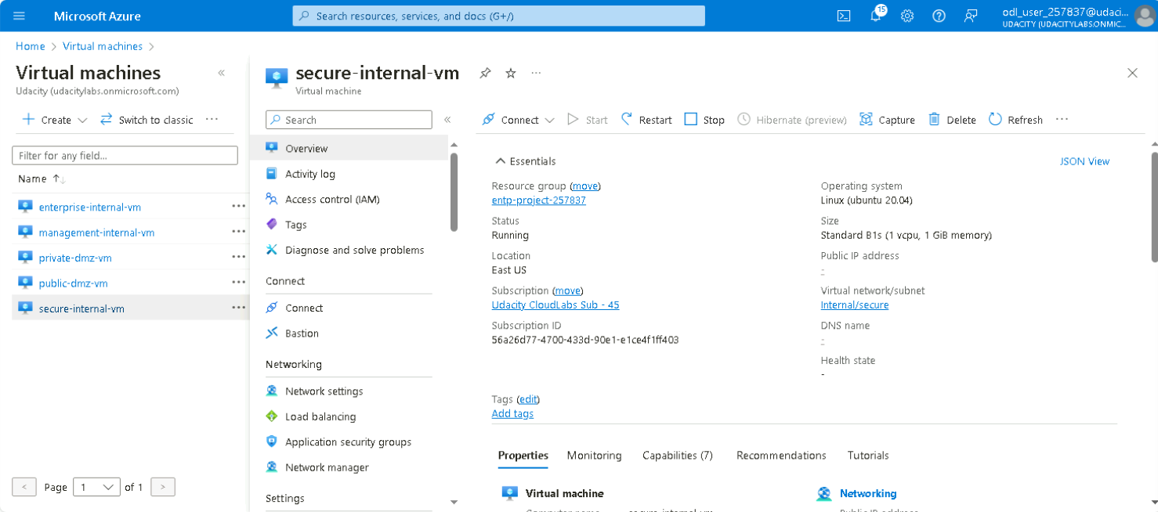
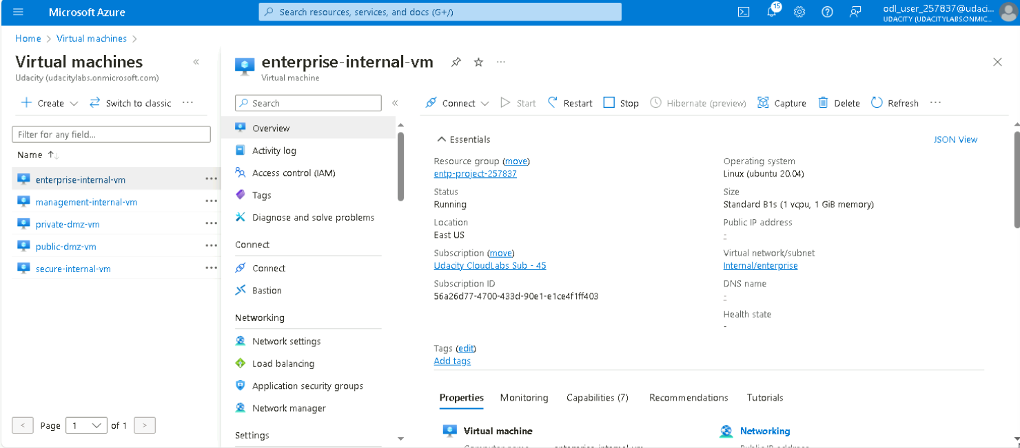

2.2.2 Screenshot
Create one VM in each of your Management, Secure, and Enterprise internal subnets. Please only use Standard_B1s for your VM size and select the Linux Ubuntu 18.04 image, otherwise you will encounter an error.

Slide 13
2.3 Secure Routing
In this next section you will configure secure routing within your Virtual Network and subnets. Follow secure best practices when creating network traffic rules.
Insert screenshots on the following pages, showing completion of each of the specified tasks.

Slide 14
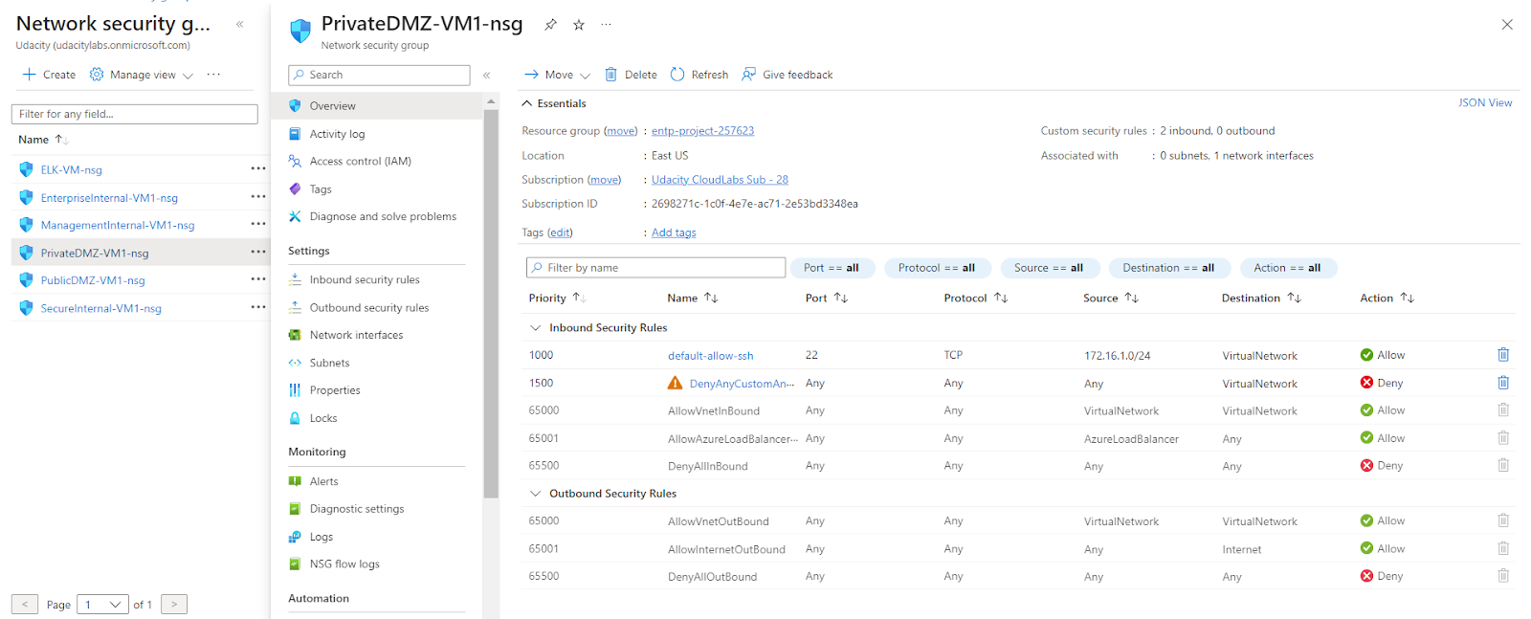
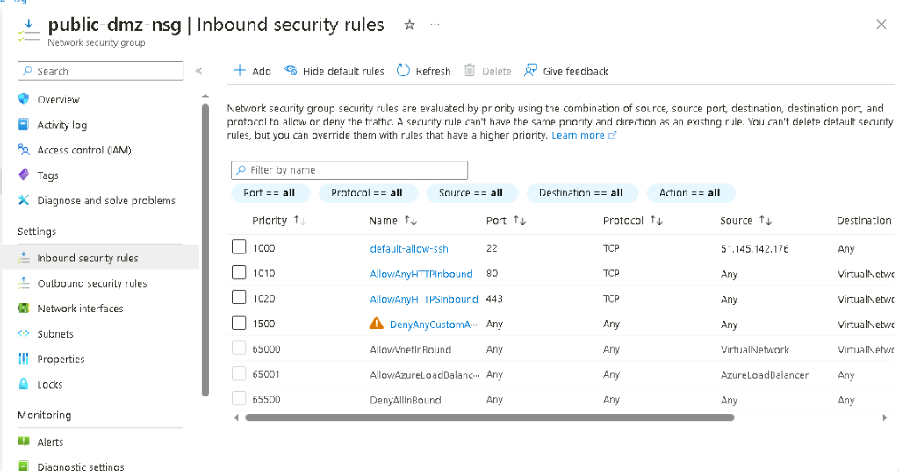
2.3.1 Screenshot
Traffic rules in your DMZ.

Slide 15
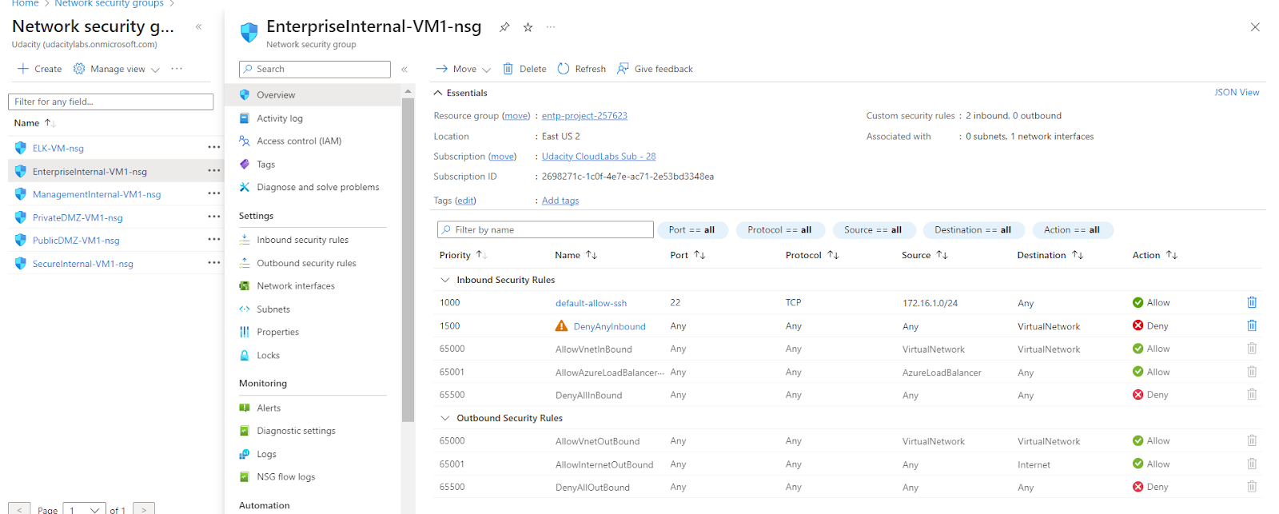
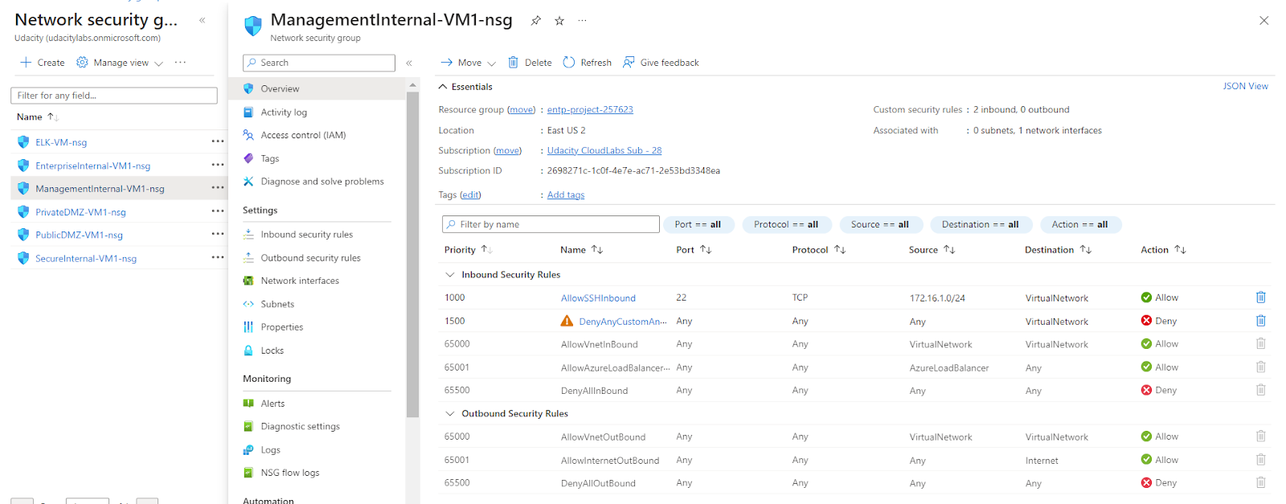
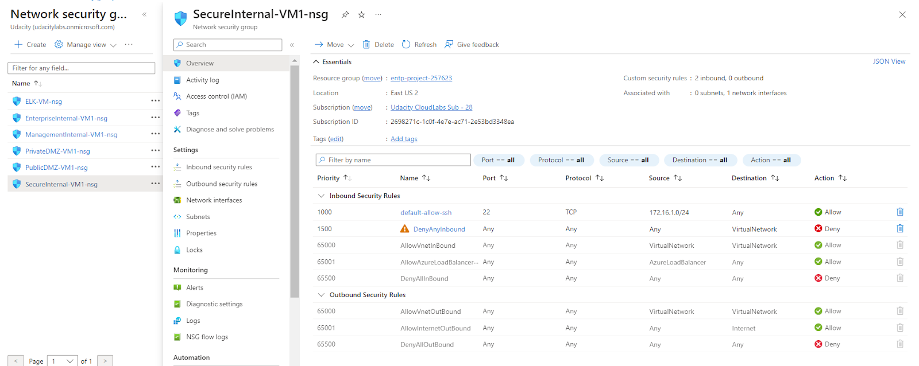
2.3.2 Screenshot
Traffic rules in your Internal network.

Slide 16
2.4 VPN Access
In this next section you will create a VPN to secure access to your internal network. After creating your VPN, test your VPN connection and attempt connecting to one of your VMs in your internal network.
Insert screenshots on the following pages, showing completion of each of the specified tasks.

Slide 17
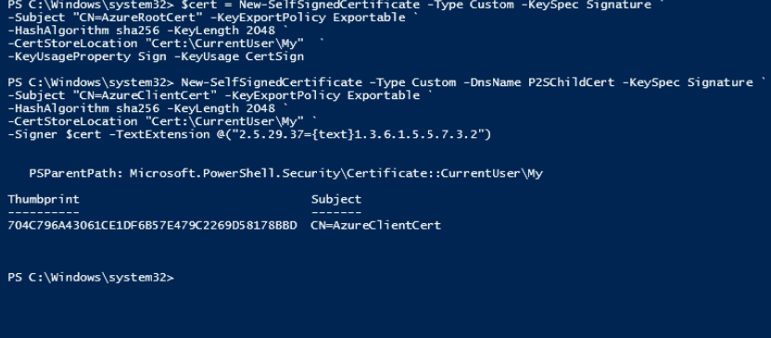
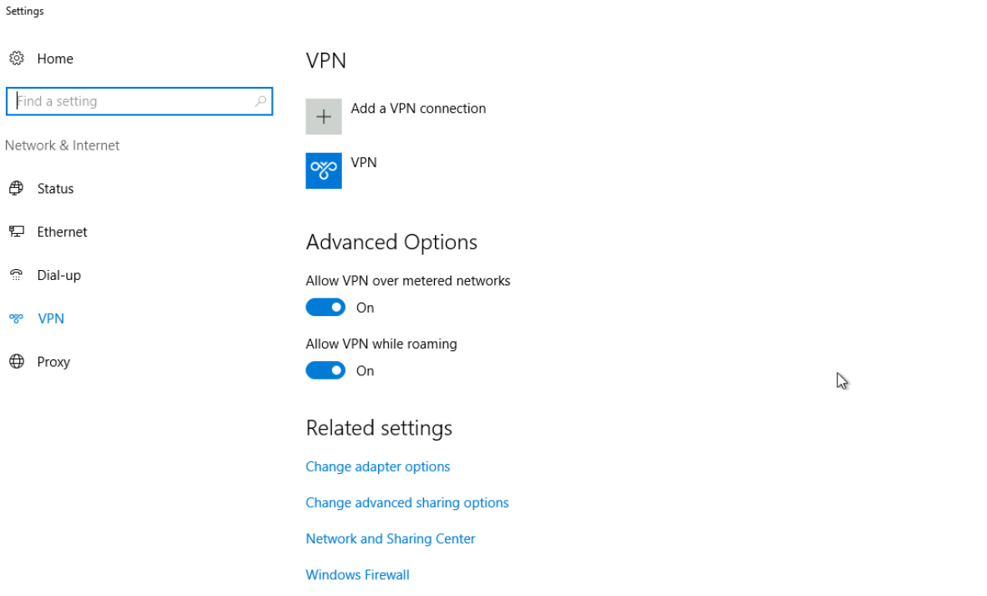
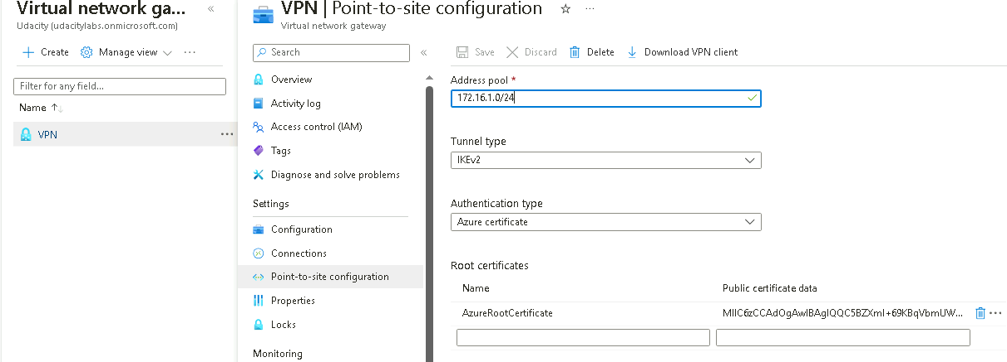
2.4.1 Screenshot
Create a VPN to connect to your internal network.

Slide 18
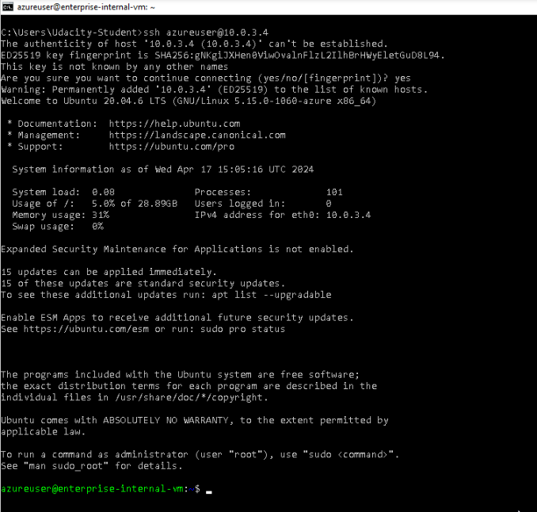
2.4.2 Screenshot
Test VPN connection by connecting to one of the VMs in your internal network.

Slide 19
Section 3
Continuous Monitoring with a SIEM

Slide 20
Section 3: Build the SIEM
Now that you've built a secure network architecture and a Zero Trust model, you're ready to wrap up your contract and finish the last piece of work. Your last task is to set up a solution to monitor the enterprise network and alert you about potential attacks.
For this section, you will continue working in the Project Workspace in the classroom, then provide screenshots of your work here in this document.
Insert screenshots on the following pages, showing completion of each of the specified tasks.

Slide 21
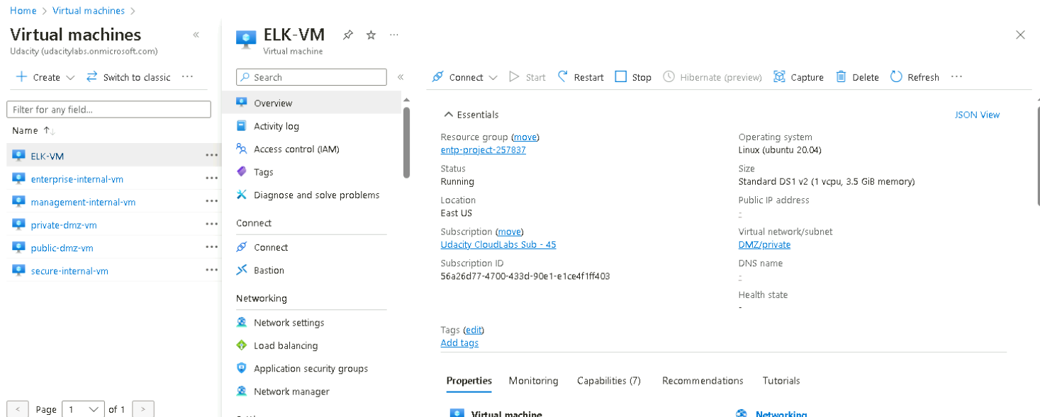
3.1.1 Screenshot
Create a VM in your private DMZ. On that VM, go through the process to create an ELK Server. For your Elk Server use the VM size DS1_v2 and Linux Ubuntu 18.04 image.

Slide 22
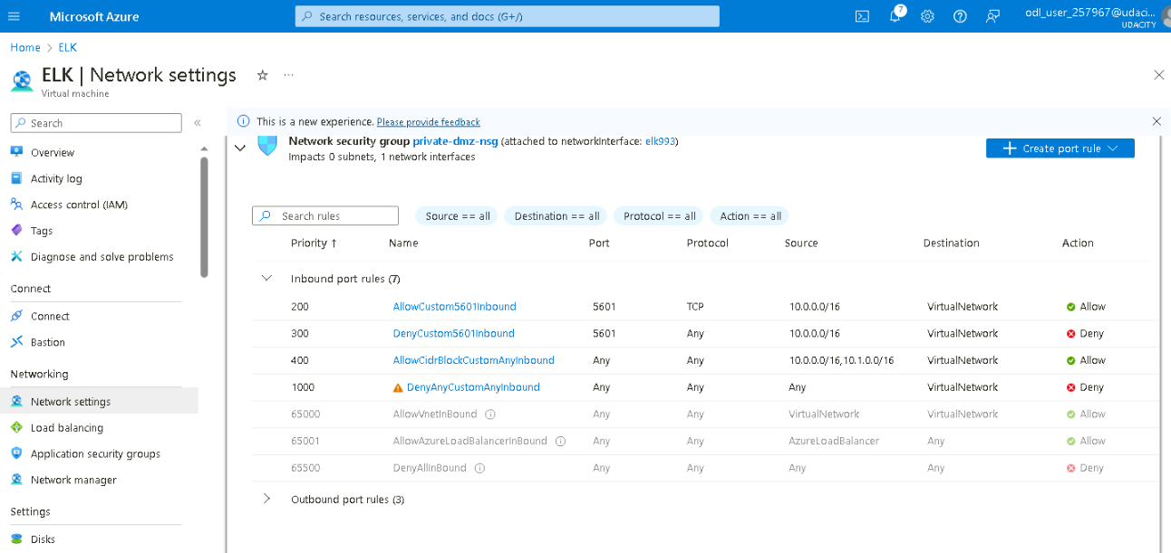
3.1.2 Screenshot
Set up routing to only allow traffic inbound to the server from both your virtual networks, and make sure Kibana is only accessible when you're on the network.

Slide 23
3.2 Ingest Logs
In this next section, you will start setting up ingest sources for your ELK server.
Insert screenshots on the following pages, showing completion of each of the specified tasks.

Slide 24
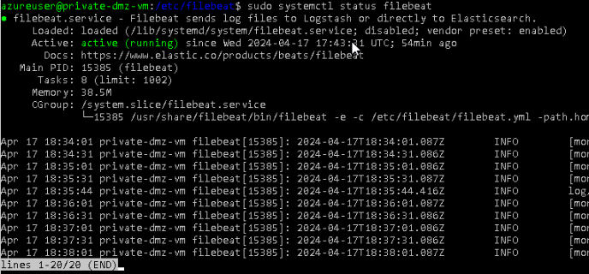
3.2.1 Screenshot
Install Filebeat on your web servers and show the Filebeat service as active.

Slide 25
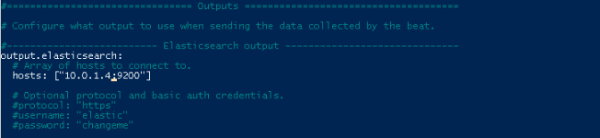
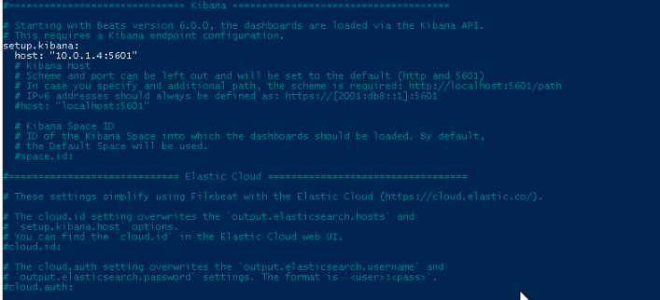
3.2.2 Screenshot
Configure Filebeat to route web server logs to Elasticsearch.

Slide 26
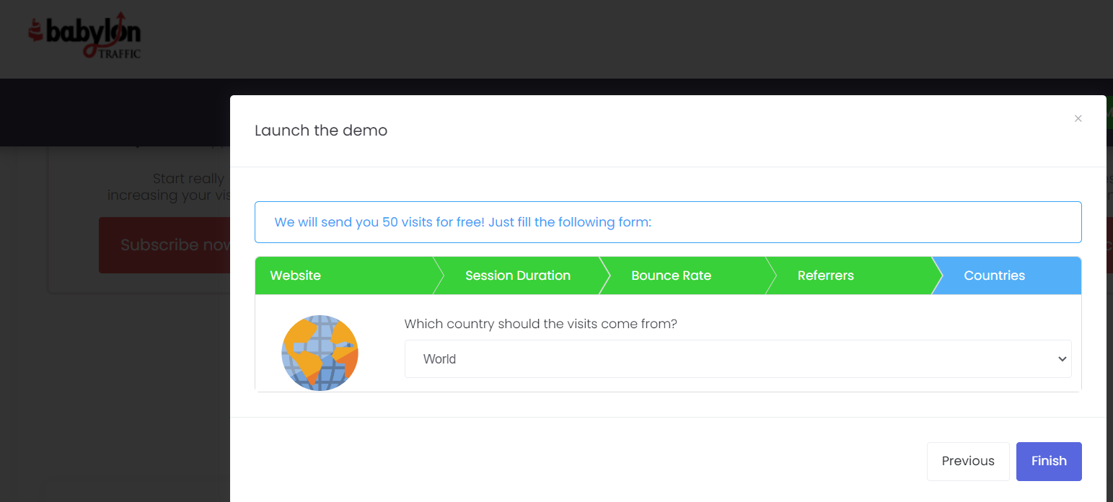
3.2.3 Screenshot
Simulate web traffic to your web servers using https://www.babylontraffic.com.

Slide 27
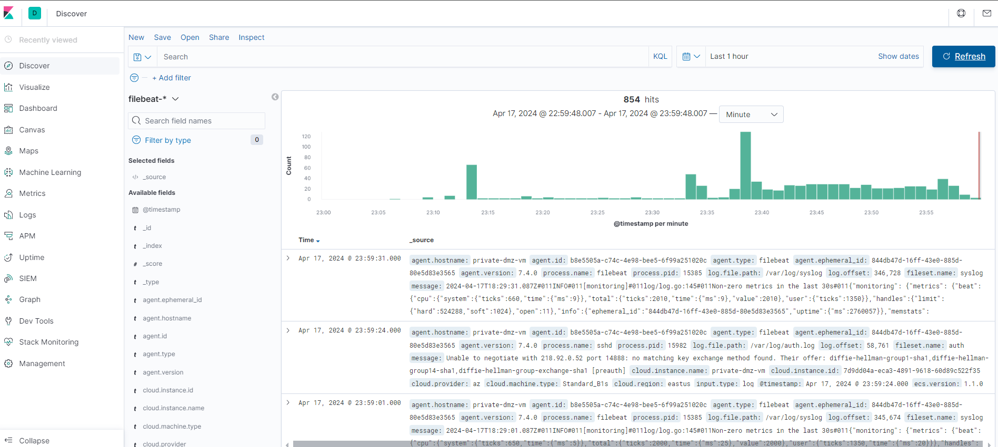
3.2.4 Screenshot
Web server logs appear in Kibana.

Slide 28
3.3 Build Alerts
In this next section, you will create alerts on the simulated web traffic you see. Build alerts to alert you of possible DoS, brute force, and probing attacks.
Insert screenshots on the following pages, showing completion of each of the specified tasks.

Slide 29
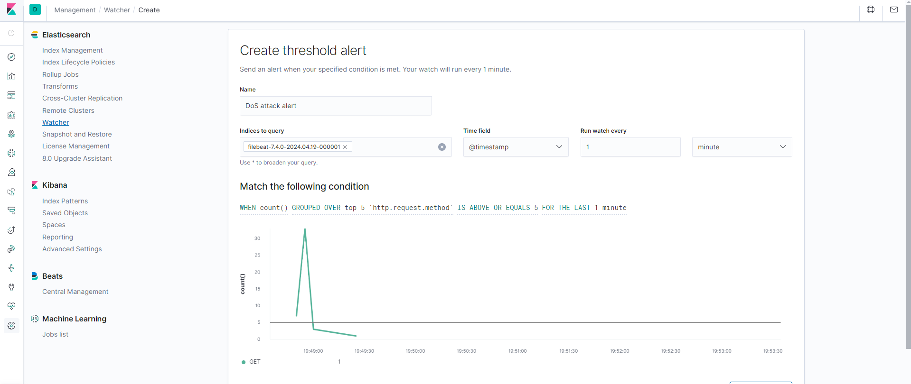
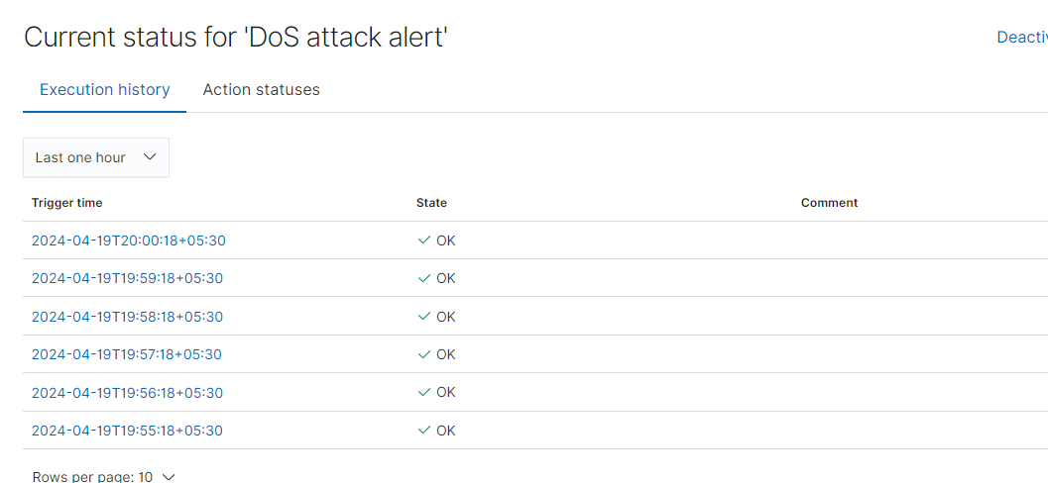
3.3.1 Screenshot
Create an alert for DoS attack.

Slide 30
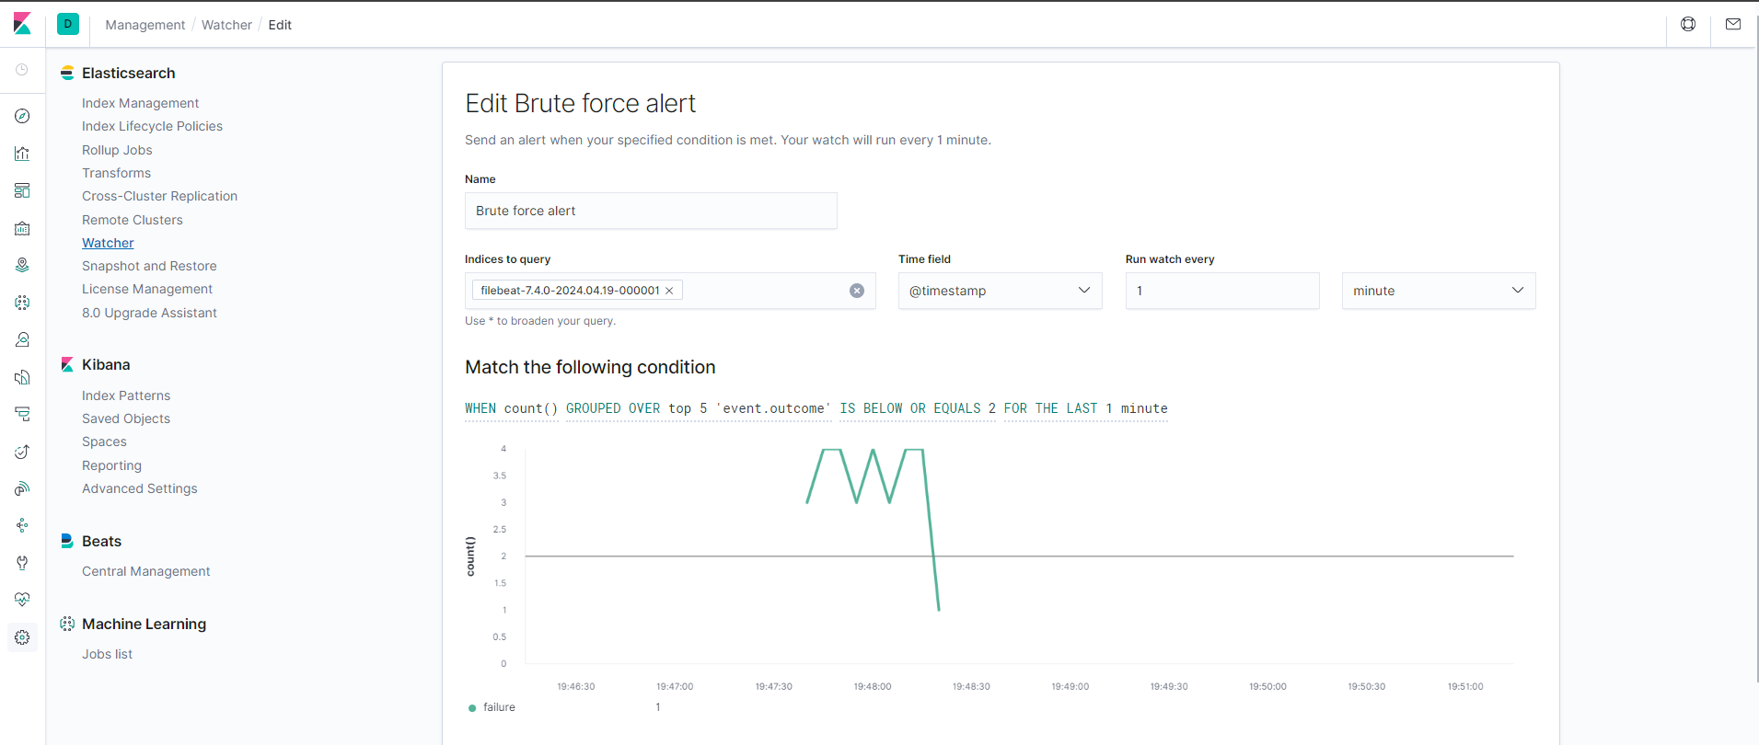
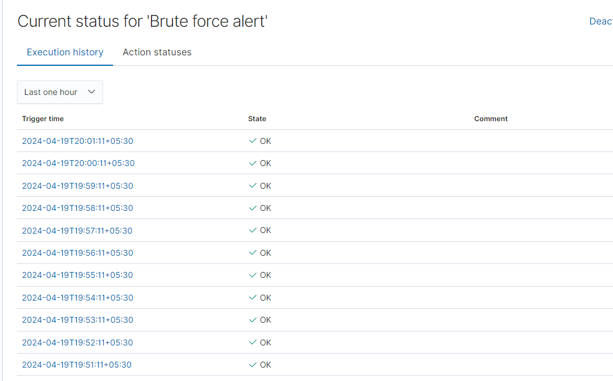
3.3.2 Screenshot
Create an alert for Brute Force attack.

Slide 31
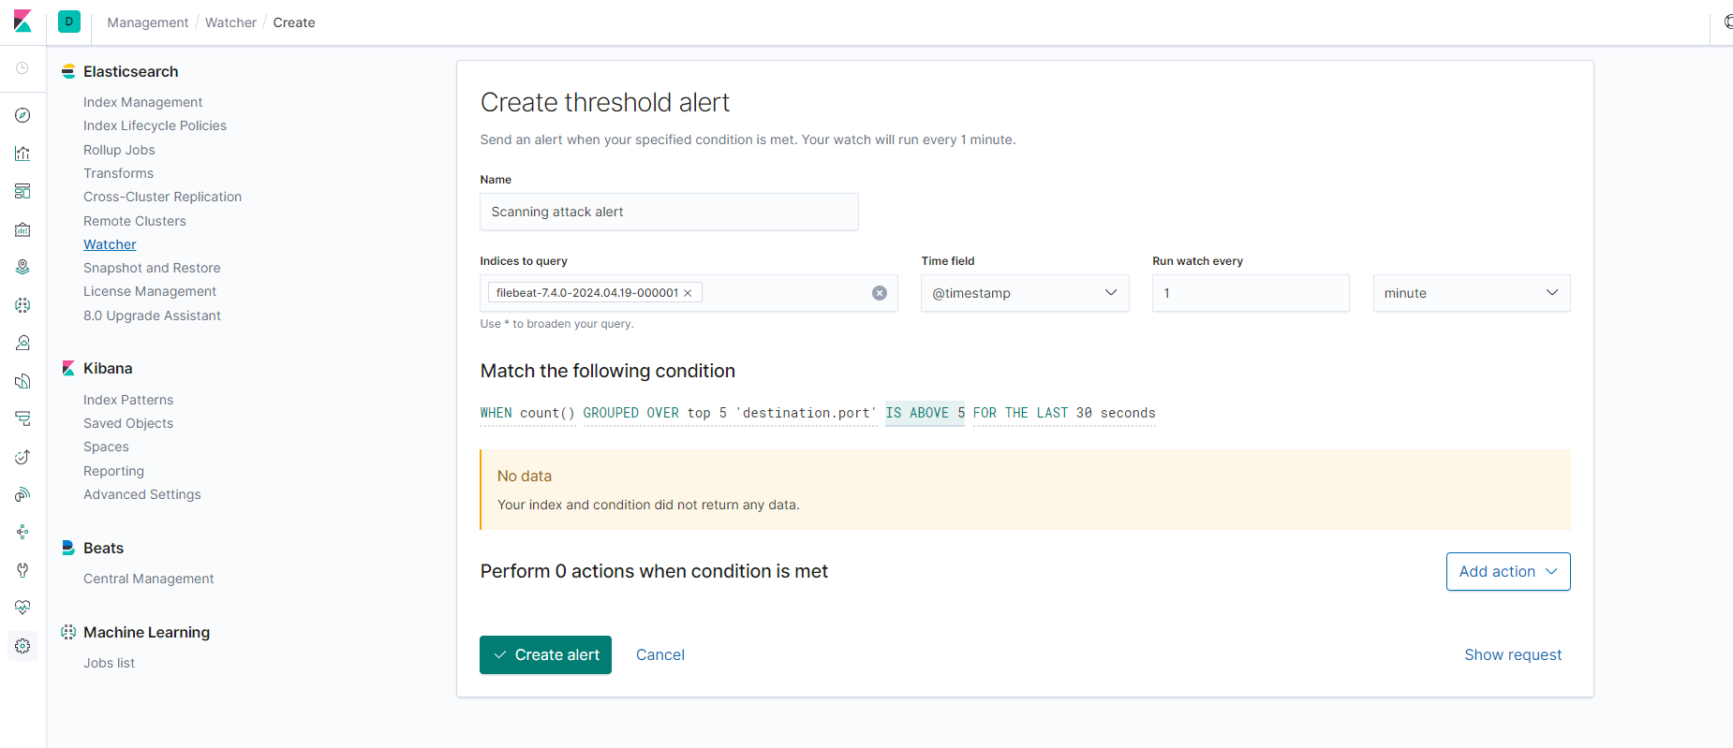
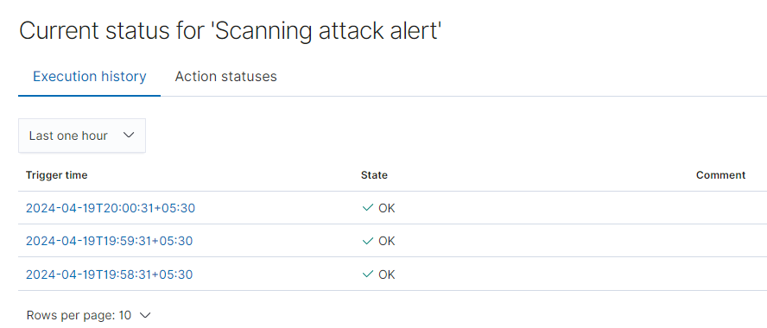
3.3.3 Screenshot
Create an alert for a scanning attack. During the scan, an attacker is looking to identify what ports are open.

Slide 32
3.4 Incident Response Playbook
Write a playbook below, detailing what the set of steps would be in response to each of the alerts you created in the last section 4.3. Add more pages if you need.
Brute Force Attack Playbook
Preparation
Define Team and Roles: Establish a team responsible for handling brute force attacks, including IT security, system administrators, and application owners. Assign clear roles for each phase (detection, analysis, containment, recovery).
SIEM systems: Utilize security information and event management (SIEM) systems to correlate login attempts from various sources and identify potential brute force attacks.
Establish Communication Plan: Define communication channels (email, chat) and escalation procedures for notifying stakeholders during an attack.
Identify Critical Accounts: List accounts with high access privileges or access to sensitive data that are prime targets for brute force attacks.
Implement Strong Password Policies: Enforce password complexity requirements (length, mix of characters) and enforce regular password changes for critical accounts.
Update security software: Regularly update security software and firmware to address vulnerabilities that attackers might exploit to gain access through brute force attacks.
Account Lockout Thresholds: Configure account lockout mechanisms after a predefined number of failed login attempts.
Monitor Login Attempts: Implement tools to monitor login attempts, including origin IP addresses and timestamps. Establish baselines for regular login activity to identify anomalies.
Detection & Analysis
Alert on Login Anomalies: Set up alerts for unusual login activity, such as:
High number of failed login attempts from a single IP address in a short period.
Login attempts from unexpected geographical locations.
Attempts to access privileged accounts outside of regular working hours.
Analyze Login Attempts: Investigate suspicious login activities. Analyse IP addresses for malicious origin using threat intelligence feeds.
Containment, Eradication & Recovery
Lock Out Accounts: Automatically lock accounts after exceeding the predefined failed login threshold.
Implement IP Blocking: Block IP addresses identified as sources of brute force attacks. Consider implementing temporary blocks with the option to unblock after a specific timeframe.
MFA for Critical Accounts: Enable multi-factor authentication (MFA) for privileged accounts and accounts with access to sensitive data.
Investigate Compromised Credentials: If a brute force attack is successful, assume the compromised account's credentials are leaked. Reset passwords for compromised accounts and potentially related accounts.
Identify Root Cause: If a vulnerability is exploited to facilitate the brute force attack, patch the vulnerability to prevent future attacks.
Post-Incident Activity
Document the Incident: Document the details of the attack, including the timeline of events, attack source (if identified), containment actions taken, and lessons learned.
Review and Improve: Conduct a post-incident review to assess the response's effectiveness and identify areas for improvement. This may involve adjusting lockout thresholds, MFA implementation, or communication protocols.
Security Awareness Training: Train users on strong password practices and how to identify phishing attempts that could lead to credential theft used in brute force attacks.

Slide 33
DoS Attack Playbook
Preparation
Define team and roles: Identify the team members responsible for DoS incident response, including IT security, network operations, and business continuity personnel. Assign clear roles and responsibilities for each phase. Train the team on DoS attack tactics, mitigation strategies, and the incident response playbook.
Establish a communication plan: Determine how the team will communicate during a DoS attack. This includes defining communication channels, escalation procedures, and protocols for notifying stakeholders.
Identify critical assets: List the essential systems and resources that must be protected from DoS attacks. This will help prioritize response efforts during an incident.
Update security software: Regularly update security software and firmware to address vulnerabilities that attackers might exploit in DoS attacks.
Baseline network traffic: Monitor and establish baseline metrics for network traffic patterns to identify anomalies that might indicate a DoS attack.
Implement DoS mitigation strategies: Configure firewalls, intrusion detection/prevention systems (IDS/IPS), and web application firewalls (WAFs) to detect and block DoS attacks. Consider implementing DDoS mitigation services offered by cloud providers or security vendors.
Prepare for recovery: Develop a plan for restoring affected systems and services after a DoS attack. This includes having backups readily available and practicing recovery procedures.
Automation: Incorporating automation tools to streamline detection, analysis, and mitigation of DoS attacks.
Detection & Analysis
Monitor for signs of DoS attacks: Monitor network traffic, system resource utilization, and application logs for unusual activity that might indicate a DoS attack. Utilize the baselines established during preparation for anomaly detection.
Alert and escalate: If a potential DoS attack is detected, trigger alerts and escalate the incident to the designated response team members according to the communication plan.
Analyze attack characteristics: Identify the type of DoS attack (volumetric, protocol, application layer) and gather information about the attack source and target.
Containment, Eradication, and Recovery
Isolate the attack: Isolate the target system or network segment from the DoS attack traffic. This may involve implementing rate limiting, blackholing malicious IP addresses, or utilizing DDoS mitigation service features.
Protect critical resources: Ensure essential systems and resources remain available during the attack. This may involve scaling resources or diverting traffic to alternate systems.
Eradicate the attack (if possible): If the attack source can be identified and isolated, stop the attack at its origin. This may involve working with law enforcement or internet service providers.
Recover affected systems: Restore affected systems and services using backups and recovery procedures established during the preparation phase.
Post-Incident Activity
Document the incident: Document all activities taken during the DoS incident response. This includes the timeline of events, attack details, mitigation strategies employed, and lessons learned.
Review and improve: Conduct a post-incident review to assess the response plan's effectiveness and identify improvement areas. This may involve updating the playbook, strengthening DoS mitigation strategies, or improving communication protocols.
Test the playbook: Regularly test the DoS incident response playbook through simulations or exercises to ensure team members are familiar with their roles and procedures.

Slide 34
Scanning Attack Playbook
Preparation
Define Team and Roles: Establish a team responsible for handling brute force attacks, including IT security, system administrators, and application owners. Assign clear roles for each phase (detection, analysis, containment, recovery).
SIEM systems: Utilize security information and event management (SIEM) systems to correlate login attempts from various sources and identify potential brute force attacks.
Establish a Communication Plan: Define communication channels (email, chat) and escalation procedures for notifying stakeholders during an attack.
Identify Critical Accounts: List accounts with high access privileges or access to sensitive data that are prime targets for brute force attacks.
Implement Strong Password Policies: Enforce password complexity requirements (length, mix of characters) and enforce regular password changes for critical accounts.
Update security software: Regularly update security software and firmware to address vulnerabilities that attackers might exploit to gain access through brute force attacks.
Account Lockout Thresholds: Configure account lockout mechanisms after a predefined number of failed login attempts.
Monitor Login Attempts: Implement tools to monitor login attempts, including origin IP addresses and timestamps. Establish baselines for regular login activity to identify anomalies.
Detection & Analysis
Alert on Login Anomalies: Set up alerts for unusual login activity, such as:
High number of failed login attempts from a single IP address in a short period.
Login attempts from unexpected geographical locations.
Attempts to access privileged accounts outside of regular working hours.
Analyze Login Attempts: Investigate suspicious login activities. Analyze IP addresses for malicious origin using threat intelligence feeds.
Containment, Eradication & Recovery
Lock Out Accounts: Automatically lock accounts after exceeding the predefined failed login threshold.
Implement IP Blocking: Block IP addresses identified as sources of brute force attacks. Consider implementing temporary blocks with the option to unblock after a specific timeframe.
MFA for Critical Accounts: Enable multi-factor authentication (MFA) for privileged accounts and accounts with access to sensitive data.
Investigate Compromised Credentials: If a brute force attack is successful, assume the compromised account's credentials are leaked. Reset passwords for compromised accounts and potentially related accounts.
Identify Root Cause (if possible): If a vulnerability is exploited to facilitate the brute force attack, patch the vulnerability to prevent future attacks.
Post-Incident Activity
Document the Incident: Document the details of the attack, including the timeline of events, attack source (if identified), containment actions taken, and lessons learned.
Review and Improve: Conduct a post-incident review to assess the response's effectiveness and identify areas for improvement. This may involve adjusting lockout thresholds, MFA implementation, or communication protocols.
Security Awareness Training: Train users on strong password practices and how to identify phishing attempts that could lead to credential theft used in brute force attacks.

Slide 35
Section 4
Designing a
Zero Trust Model

Slide 36
Section 4: Zero Trust Model
XYZ is elated with the work you've done so far! But they've been hearing about this new buzzword "Zero Trust" and are curious as to what it is and what the architecture would look like in a Zero Trust model. So your next task below is to design a Zero Trust model, then explain the differences between your network architecture and your Zero Trust model.
Design a Zero Trust model of your network architecture using https://app.diagrams.net/.
Make sure to incorporate the following into your design:
- Identity
- Devices
- Apps
- Network
- Data
- Infrastructure
- Trusted and Untrusted Devices
- Controls

Slide 37
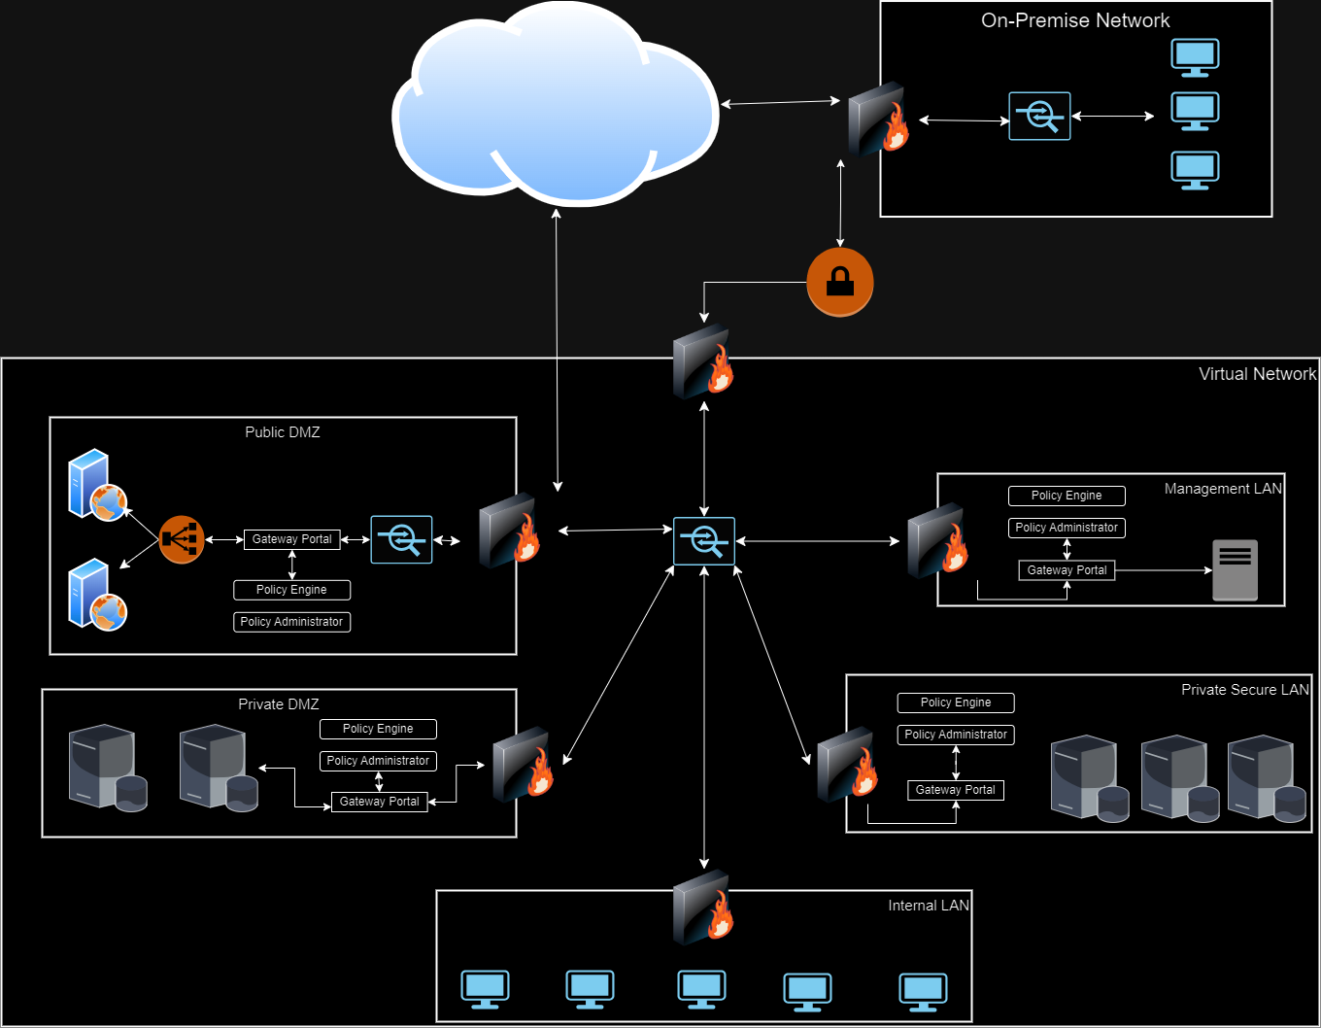
4.1 Zero Trust Model
Paste your Zero Trust model diagram here:
Remove this slide

Slide 38
4.2 Modern Architecture vs. Zero Trust
Write a detailed comparative analysis of the differences between your Zero Trust model and your secure network architecture design.
1. Trust Assumption:
- Traditional: Trust is established once inside the network.
- Zero Trust: Trust is never assumed; verification is required for every access request.
2. Network Segmentation:
- Traditional: Basic segmentation with less strict access controls.
- Zero Trust: Extensive micro-segmentation with strict access controls throughout the network.
3. Device Trust:
- Traditional: Trust in company-managed devices.
- Zero Trust: All devices are treated as potentially hostile, with continuous security posture assessment.
4. Identity and Access Management:
- Traditional: Less stringent user identity verification.
- Zero Trust: Strong Identity and Access management controls.
5. Data Protection:
- Traditional: Data security focused on perimeter defence.
- Zero Trust: Data encryption throughout the network, tightly controlled access based on roles.
6. Application Security:
- Traditional: Implicit trust in internal applications.
- Zero Trust: Applications must authenticate, with continuous monitoring and access based on user identity.
7. Infrastructure Management:
- Traditional: Centralized management with limited micro-segmentation.
- Zero Trust: Infrastructure managed as code for consistent, secure deployments and enhanced visibility.
8. Continuous Authentication:
- Zero Trust emphasizes continuous authentication and authorization for all users and devices.
9. Granular Access Controls:
- Zero Trust enforces strict access controls at a granular level, not just at the perimeter.
10. Dynamic Access Controls:
- Zero Trust implements dynamic access controls that adjust permissions based on the access request context.

